Slide 1
POWER PLANT ENGINEERING
Diesel Engine Power Plant
ADC/ACC OF BIET
Er.Pradyumna Maharana ( Mechanical Engg.)
BIET,Berhampur
Dt- 6th May 2020 , 5.16PM

Slide 2
~CONTENT~
* Introduction
* Advantages and disadvantages of diesel Power Plant
* Application of diesel power plant
* Layout of a diesel engine power plan With Essential components
* Different system of diesel power plant :(Briefly)
1.Fuel storage & Fuel supply system
2.Fuel injection system
3.Air-supply system
4.Exhaust system
5.Cooling system
6.Lubrication system
7.Starting system
8.Governing system
* Previous Year Question’s
* Additional Question’s with Answer

Slide 3
DIESEL ENGINE POWER PLANT Pg-1
Introduction :- Diesel engine power plants are installed where supply of coal and water is not available in sufficient quantity or where power is to be generated in small quantity or where standby sets are required for continuity of supply such as in hospitals, telephone exchanges, radio stations and cinemas .
- Diesel power plant produces power in the range of 2 to 50 MW .
- The diesel units used for electric generation are more reliable and long-lived piece of equipment compared with other type of plants .
Advantages and Dis-advantages of Diesel power Plant :-
Advantages – (i) Design and installation are very simple . (ii) Can respond to verify loads without any difficulty . (iii)The standby losses are less. (iv)Occupy less space (v)Can be started and put on load quickly . (vi)Require less quantity of water for cooling purposes . (vii)Overall capital cost is lesser than that for steam plants . (viii)Require less operating and supervising staff as compared to that for steam plants . (ix)The efficiency of such plants at part loads does not fall so much as -

Slide 4
Pg-2
that of a steam plant . (x) The cost of building and civil engineering works is low . (xi)Can burn fairly wide range of fuels . (xii)These plants can be located very near to the load centres, many times in the heart of the town . (xiii)No problem of ash handling . (xiv)The lubrication system is more economical as compared with that of a steam power plant . (xv) The diesel power plant is more efficient than steam power plants in the range of 150 MW capacity . (xvi)They can be employed in all climatic zones . (xvii)Manufacturing period are short, therefore a diesel station may be rapidly extended to keep pace with load growth by just adding the generating units of suitable sizes . (xviii)Were skilled labour is scarce, the full automation of diesel station can be provided
Dis-advantages :- (i)High operating cost . (ii)High maintenance and lubrication cost . (iii)Diesel unit capacity is limited . These can’t be constructed in large size . (iv)In a diesel power plant noise is a serious problem .

Slide 5
Pg-3
(v) Diesel plants can’t supply overloads continuously whereas steam power plant can work under 25% overload continuously .
(vi) The diesel power plants are not economical where fuel has to be imported .
(vii) The life of a diesel power plant is quite small (2 to 5 years or less ) as compared to that of a steam power plant (25 to 30 years ) .
APPLICATION OF DIESEL POWER PLANT :- The diesel power plants find wide application in the following fields :
1. Peak load plants 2.Mobile plants
3. Stand-by unit 4.Emergency plant
5.Nursery station 6.Starting stations
7.Central stations- Where capacity required is small (5 to 10MW ). 8.Industrial concerns where power requirement is small say of the order of 500 kW, diesel power plants become more economical due to their higher overall efficiency .

Slide 6
Pg-4
* DIESEL POWER PLANT LAYOUT WITH ESSENTIAL COMPONENTS *
Fig.(a) shows layout of a Diesel Engine plant . The essential components of Diesel engine power plant are ;
1. Engine :- It is the main component that develops required power . The engine is directly coupled to the generator as shown in fig.(a) .
Fig.(a) Layout of Diesel engine Power Plant

Slide 7
Pg-5
2. Air filter and supercharger :- Air filter removes the dust from the air before it enters the engine. Supercharger increases the pressure of air at engine inlet and hence increases engine power. They are usually driven by the engines.
3. Exhaust system:- The system includes silencers and connecting ducts. As the exhaust gases have higher temperatures, heat of exhaust gases is utilized for heating the oil or air supplied to the engine.
4. Fuel system:- It contains the storage tank, fuel pump, fuel transfer pump, oil strainers and heaters. The amount of fuel supplied depends on the load on the plant.
5. Cooling system:- The system includes water circulating pumps, cooling towers or spray ponds and water filtration or treatment plant. The purpose of cooling system is to ensure the life of the cylinder by extracting the heat developed from the engine cylinder walls and hence keeping the temperature within the safer range.
6. Lubrication system:- The system includes oil pumps, oil tanks coolers and connecting pipes. The system reduces friction between the moving parts and hence reduces wear and tear.

Slide 8
Pg-6
7. Starting system:- The system includes starting aides such as compressed air tanks. The tank supplies compressed air to start the engine from cold.
8. Governing system:- The governing engine maintains constant speed of the engine irrespective of load on the plant. This is done by varying the fuel supplied to the engine.
* Different System of Diesel Engine Power Plant *
1.FUEL STORAGE & FUEL SUPPLY SYSTEM
- The fuel storage and fuel supply system depends upon the type of fuel, size of the plant and type of engine used .
- The fuel supply system is generally classified as a two types ; (i) Simple suction system & (ii) Transfer system .
- In simple suction, the oil is taken by a suction pump driven by engines from service tank located of few Cm below the engine level . Such pump delivers constant volume of fuel therefore an over flow line is required back to the tank . This system is used for small capacity plant .
- In transfer system. The pump delivers fuel from the underground storage to day storage tank . The fuel from the day storage tank flows under gravity to engine fuel pump . This type of system is used for medium size or large size plant .
- The location of storage tank above or below the ground depend upon the local condition .The over ground tank has the advantage of detecting leak--

Slide 9
Pg-7
easily , low maintenance and easy cleaning . The under ground tank has the advantages of reduced fire hazards .
- The heating requirements depends upon the climatic condition and viscosity of the fuel used . If the heating is required , then it is generally done in the storage tank by passing the hot hacket water through a coil dipped in the storage tank .
2.FUEL INJECTION SYSTEM
- Fuel injection system is the mechanical heart of diesel engine power plant.
- The engine can be performed no better than it’s fuel injection system .
- The efficiency of the engine depends upon the proper mixing of fuel-
Fig.(b)Fuel system of Diesel Power Plant

Slide 10
Pg-8
with air . Generally solid injection is used .
- The fuel at a pressure of 100 to 200 bar is injected through the nozzle into the compressed air which also helps to atomise the fuel .
- Function of Fuel injection system :- (i)Filter the fuel (ii)Meter or measure the correct-quantity of fuel to be injected . (iii)Time the fuel injection (iv)Control the rate of fuel injection . (v)Automise or break up the fuel to fine particles . (vi)Properly distribute the fuel in the combustion chamber .
- Type of Fuel injection system :- The following fuel injection systems are commonly used in diesel power station :
(a) Common-rail injection system
(b) Individual pump injection system
(c) Distiributor
(a). Common-rail injection system :-
- Two types of common rail injection systems are shown in Figure.(c) and Fig.(d) respectively.
- In fig.(c) , a single pump supplies high-pressure fuel to header. A relief valve holds pressure constant. The control wedge adjusts the lift of mechanical operated valve to set the amount and time of injection.

Slide 11
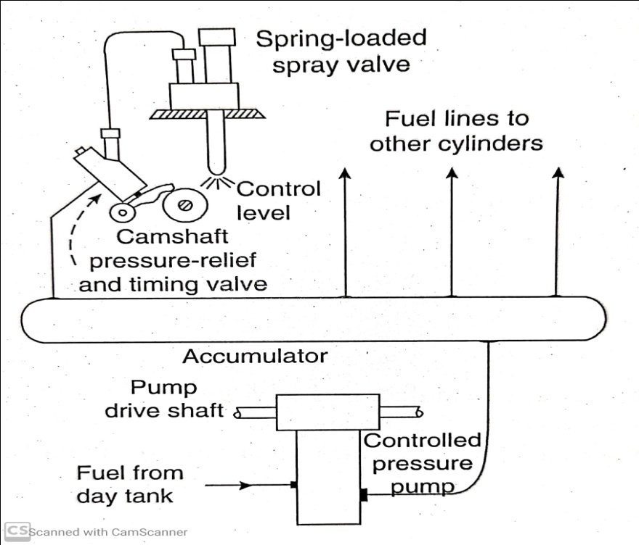
Pg-9
Fig.(d) shows a controlled pressure system. It has a pump that maintains set head pressure. Pressure relief and timing valves regulate injection time and amount. Spring loaded spray valve acts merely as a check.
(b).Individual Pump injection system:- An individual pump injection system is shown in Figure 13.11. In this system, an individual pump cylinder connects directly to each fuel nozzle . Pump meters charge and control injection timing. Nozzles contain a delivery valve that is actuated by the fuel oil pressure
Fig.(c) common-rail injection system using a single pump
Fig.(d) controlled pressure system

Slide 12
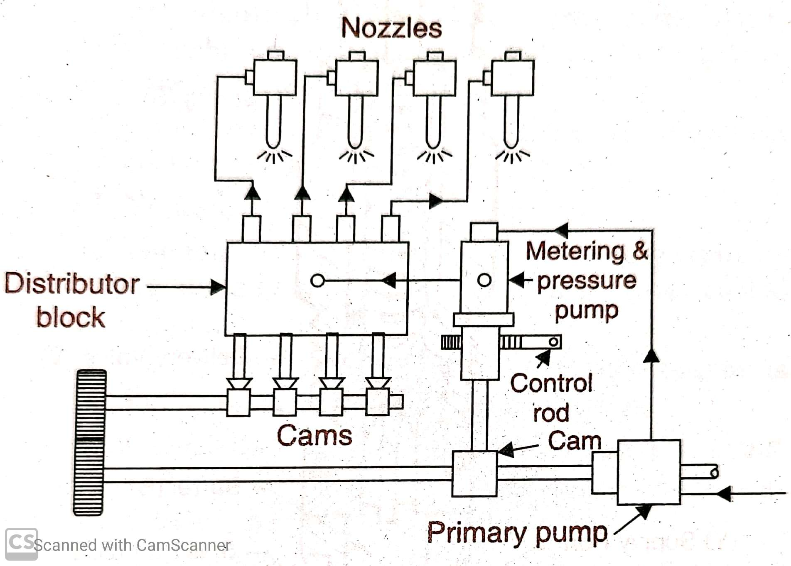
Pg-10
Fig.(e)Individual pump injection system
(c). Distributor system :- Most commonly used distributor system is shown in Figure 13.12. In this system, the fuel is metered at a central point. A pump pressurizes, meters the fuel and times the injection. The fuel is then distributed to cylinders in correct firing order by cam-operated poppet valves that open to admit fuel to the nozzles.
Fig.(f)Distributor system

Slide 13
Pg-11
3.AIR-SUPPLY SYSTEM
Generally a large diesel engine requires 0.076 to 0.114 m3 of air per min per kw of power developed. The fresh air is drawn through pipes or ducts or filters. The purpose of the filter is to catch any air borne dirt as it otherwise may cause the wear and tear of the engine. The filters may be of dry or oil bath. The filters should be cleaned periodically. Electrostatic precipitator filters can also be used. Oil impingement type of filter consists of a frame filled with metal shavings which are coated with a special oil so that the air in passing through the frame and being broken up into a number of small filaments comes into contact with the oil whose property is to seize and hold any dust particles being carried by the air. The dry type of filter is made of cloth, felt, glass wool etc. In case of oil bath type of filter the air is swept over or through a pool of oil so that the particles of dust become coated. Light weight steel pipe is the material for intake ducts.
- Since the noise may be transmitted back to the outside air via the air intake. So, A silencer is needed in between the engine and the intake system.

Slide 14
Pg-12
- There should be minimum pressure loss in the air intake system, otherwise specific fuel consumption will increase and the engine capacity is reduced.
- The air intake system conveys fresh air through pipes or ducts to:
1. Air-intake manifold of four-stroke engine.
2. The scavenging pump inlet of a two-stroke engine.
3. The supercharger inlet of a supercharged engine.
- The air intake may be located:
(a) Very Near the ground and outside the plant building.
(b) In the building roof.
(c) On the building roof.
(d) Inside the engine room.
- Following precautions should be taken while constructing a suitable air intake system:
1. They do not locate the air-intakes inside the engine room.
2. Do not take air from a confined space as otherwise serious
vibration problems can occur due to air pulsations.

Slide 15
Pg-13
3. Do not use air-intake line with too small a diameter or which is too long, otherwise engine starvation might occur.
4. Do not install air-intake filters in an inaccessible location.
5. Do not locate the air intake filters close to the roof of the engine room since serious vibrations of the roof may occur due to pulsating airflow through the filters.
Fig.(g)Air intake system
4. EXHAUST SYSTEM
The purpose of the exhaust system is to discharge the engine exhaust to the atmosphere outside the main building.
The exhaust manifold connects the engine cylinder exhausts outlet to the exhaust pipe which is provided with a muffler to reduce pressure in the exhaust lines and eliminate most of the noise which may result if gases are discharged directly into the atmosphere .
- For designing of exhaust system of a big power plant, following points should be taken into consideration .
1. Exhaust noise should be reduced to a tolerable degree.

Slide 16
Pg-14
2. To reduce the air pollution at breathing level, Exhaust should be exhausted well above the ground level .
3. Pressure loss in the system should be reduced to minimum.
4. By use of flexible exhaust pipe, the vibrations of exhaust system must be isolated from the plant.
5. A provision should be made to extract the heat from exhaust if the heating is required for fuel oil heating or building heating or process heating.
- In many cases, we have seen that the temperature of the exhaust gases under full load conditions may be of the order of 400°C. With the recovery of heat from hot jacket water and exhaust gases and its use either for heating oil or buildings in cold weather increase the thermal efficiency to 80%. Nearly 40% of the heat in the fuel can be recovered from the hot jacket water and exhaust gases.
Fig.(h)Exhaust system

Slide 17
Pg-15
- The heat from the exhaust can also be used for generating the steam at low pressure that can be used for process heating. Nearly 2 kg of steam at 8 kg/cm2 can be generated per kW per hour, when the mass of exhaust gases can be taken as 10 kg/kW hr.
5.COOLING SYSTEM
- During combustion process the peak gas temperature in the cylinder of an internal combustion engine is of the order of 2500 K. Maximum metal temperature for the inside of the combustion chamber space are limited to much lower values than the gas temperature by a large number of considerations and thus cooling for the cylinder head, cylinder and piston must therefore be provided. Necessity of engine cooling arises due to the following facts
1. During combustion period, the heat fluxes to the chamber walls can reach as high as 10 mW/m2. The flux varies substantially with location. The regions of the chamber that are contacted by rapidly moving high temperature gases generally experience the highest fluxes. In region of high heat flux, thermal stresses must be kept below levels that would cause fatigue cracking. So temperatures must be less than about 400°C for cast iron and 300°C for aluminium alloy for water cooled engines.

Slide 18
Pg-16
- For air-cooled engines, these values are 270°C and 200°C respectively.
2. The gas side surface temperature of the cylinder wall is limited by the type of lubricating oil used and this temperature ranges from 160°C to 180°C. Beyond these temperature, the properties of lubricating oil deteriorates very rapidly and it might even evaporates and burn, damaging piston and cylinder surfaces. Piston seizure due to overheating resulting from the failure of lubrication is quite common.
3. The valves may be kept cool to avoid knock and pre-ignition problems which result from overheated exhaust valves (true for S.I. engines).
4. The volumetric and thermal efficiency and power output of the engines decrease with an increase in cylinder and head temperature.
- Based on cooling medium two types of cooling systems are in general use. They are
(a) Air as direct cooling system.
(b) Liquid or indirect cooling system.
- Air-cooling is used in small engines and portable engines by providing fins on the cylinder. Big diesel engines are always liquid (water/special liquid) cooled.
- Liquid cooling system is further classified as
(1) Open cooling system
(2) Natural circulation (Thermo-system)
(3) Forced circulation system
(4) Evaporation cooling system.

Slide 19
Pg-17
1.Open cooling System :-This system is applicable only where plenty of water is available. The water from the storage tank is directly supplied through an inlet valve to the engine cooling water jacket. The hot water coming out of the engine is not cooled for reuse but it is discharged.
2.Natural Circulation System :- -The system is closed one and designed so that the water may circulate naturally because of the difference in density of water at different temperatures. Fig. 8.14 shows a natural circulation cooling system.
- It consists of water jacket, radiator and a fan. When the water is heated, its density decreases and it tends to rise, while the colder molecules tend to sink.
- Circulation of water then is obtained as the water heated in the water jacket tends to rise and the water cooled in the radiator with the help of air passing over the radiator either by ram effect or by fan or jointly tends to sink. Arrows show the direction of natural circulation, which is slow.

Slide 20
Pg-18
Fig.(i)Natural Cooling system
3.Forced Circulation Cooling System :-
- Fig. 8.15 shows forced circulation cooling system that is closed one. The system consists of pump, water jacket in the cylinder, radiator, fan and a thermostat. The coolant (water or synthetic coolant) is circulated through the cylinder jacket with the help of a pump, which is usually a centrifugal type, and driven by the engine. The function of thermostat, which is fitted in the upper hose connection initially, prevents the circulation of water below a certain temperature (usually upto 85°C) through the radiation so that water gets heated up quickly.
- Standby diesel power plants upto 200 kVA use this type of cooling. In the case of bigger plant, the hot water is cooled in a cooling tower and recirculated again. There is a need of small quantity ofcooling make-up water.

Slide 21
Pg-19
Fig.(j)Forced circulation system
6. LUBRICATION SYSTEM
- Lubrication is the admittance of oil between two surface having relative motion.
- The purpose of lubrication may be one or more of the following ; 1. Reduce friction and wear between the parts having relative motion . 2. To cool the surfaces by carrying away heat generated due to friction . 3. To seal a space adjoining the surfaces such as piston rings and cylinder liner . 4. To clean the surface by carrying away the carbon and metal particles caused by wear . 5. To absorb shock between bearings and other parts and consequently reduce noise .

Slide 22
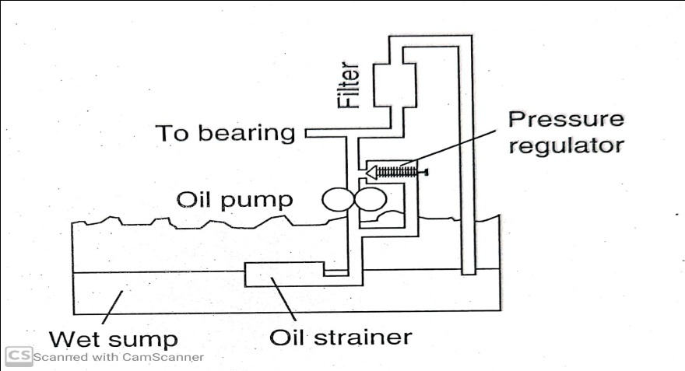
Pg-20
- This lubricating oil is drawn from the tank by means of oil pump . Then the oil is passed through the oil filter for removing impurities . From the filtering point, this clean lubricating is delivered to the different points of the machine where lubrication is required the oil cooler is provided in the system to keep the temperature of the lubricating oil as low as possible .
- The main parts of an engine which need lubrication are as given below :
(i) Main crankshaft bearings (ii) Big-end bearings (iii) Small end or gudgeon pin bearings (iv) Timing gears (v) Piston rings and cylinder walls (vi) Valve mechanism (vii)Cam shaft & cam shaft bearing (viii)Valve guides, valve -
tappets & rocker arms
- Various lubrication system used for IC engine may be classified as ; 1.Liquid lubricants or wet sump lubrication system 2.Solid lubricants or dry sump lubrication system 3.Mist lubrication system
1.Liquid lubricants or wet sump lubrication system :- These system employ a large capacity oil sump at the base of crank chamber, from which the oil is drawn by a low-pressure oil pump and delivered to various parts . ---
Fig.(k)Wet sump lubrication system

Slide 23
Pg-21
Oil then gradually returns back to the sump after serving the purpose .
2.Solid lubricants or dry sump lubrication system :- In this system, the oil from the sump is carried to a separate storage tank outside the engine cylinder block . The oil from sump is pumped by means of a sump pump through filter to the storage tank. Oil from storage tank is pumped to the engine cylinder through oil cooler . Oil pressure may very from 3 to 8 kgf/cm². Dry sump lubrication system is generally adopted for high capacity engines .
fig.(l)Dry sump lubrication system
3.Mist lubrication system :- This system is used for two stroke cycle engine. Most of these engines are crank charged, i.e, they employ crank case compression and thus, are not suitable for crank case lubrication . These engines are lubricated by adding 2 to 3 percent lubricating oil in the fuel tank . The oil and fuel mixture is induced through the carburetor . The gasoline is vaporized ; and the oil in the form of mist , goes via crank case into the cylinder .

Slide 24
Pg-22
7.STARTING SYSTEM
- The commonly used starting system in large and medium size engines are ; 1. Starting by an auxiliary engine
2. Use of electric motors or self starters
3. Compressed air system
1.Starting by an auxiliary engine (generally petrol driven ): In this system an auxiliary engine is mounted close to the main engine and drives the latter through a clutch and gears . The clutch is first disengaged and the auxiliary engine started by hand or by a self starter motor .When it has warmed up and runs normally the drive gear is engaged through the clutch, and the main engine is cranked for starting . To avoid the danger of damage to drive gear it is desirable to have an over-running clutch or starter type drive .
2.Use of electric motors or self starters : These are employed for small diesel and gasoline engines . A storage battery of 12 to 36 volts is used to supply power to an electric motor which is geared to the flywheel with arrangement for automatic disengagement after engine has started . The motor draws a heavy current and is designed to be engaged continuously for about 30 seconds only, after which it is required to cool off for a minute or so , and then re-engaged .This is done till the engine starts up . When the engine is running a small D.C. generator on the engine serves to charge the battery .

Slide 25
Pg-23
3.Compressed air system : The compressed air system is commonly used for starting large diesel engine employed for stationary power plant service . Compressed air at about 17 bar supplied from an air tank or bottle is admitted to a few of the engine cylinder making them work like reciprocating air motors to run the engine shaft . Fuel is admitted to the remaining cylinders and ignites in the normal way causing the engine to start . The air bottle or tank is charged by a motor or gasoline engine driven compressor . The system includes the following ;
(i) Storage tank / vessel
(ii) A safety valve
(iii) Interconnecting pipe work
Procedure of starting system : (i) In case of electric motor starting check the condition of storage battery . If compressed air system is used , then air pressure may be checked first and the air system inspected for possible leakage . (ii) As prescribed by the manufactures, all necessary checks for fuel, lubricating oil and cooling water should be made . (iii)Crank the engine after ensuring that all load is put off and decompression device is in use, and then let it starts .

Slide 26
Pg-24
(iv) For a few minutes run the engine at slow speed and observe the working of fuel pumps , lubricating system , fuel and oil pressure etc . The lubrication of generator and excited bearing should also be checked.
(v) Increase the engine speed gradually till it synchronizes with the station bus-bar .
(vi) Connect the generator to bus-bar when it is synchronism and increase the engine speed till it beings to share the desired load .
- Stopping of Engines :- (i) Reduce the speed of the engine gradually until practically no power is delivered by the alternator .
(ii) Dis-connect the unit from the bus and allow the engine to idle for a few a minute, and then stop it in confirmity with the instructions detailed by the manufacture .
8.GOVERNING SYSTEM
- The function of the governing system is to maintain the speed of the engine contact irrespective of load on the plant .
- This is done generally varying the fuel supply to the engine according to the load.
- It is achieved with use of governor’s .

Slide 27
Pg-25
2 Marks
Q.1)Why inlet manifold and exhaust manifold are used .(2019 S)
Q.2)What is the necessity of diesel engine power plant . (2018 S)
Q.3)What is the function of injection system in a diesel power plant .(2017 S)
Q.4)Write down the main system of diesel engine power plant .(2017 W)
5 Mark’s
Q.1)Compare 4-stroke diesel with 2-stroke diesel engine . (2019 S)
Q.2)Mention the advantages and dis-advantages of a diesel power plant over a thermal power plant . (2018 S)
Q.3)Explain the fuel storage & supply system of a diesel power plant .(2017S)
Q.4)Write down working of a diesel power plant . (2017 W)
Q.5)Write various type of lubricants . (2011 S)
Q.6)Given the layout of a diesel engine power plant showing all the system . (2009 S)
* PREVIOUS YEAR QUESTION’S *

Slide 28
Pg-26
LONG QUESTION’S
Q.1).Explain the detail about the exhaust system . (2019 S)
Q.2)Explain with neat sketch the cooling system of a diesel engine power plant . (2018 S)
Q.3)State the advantages and dis-advantages of a diesel power plant over steam plant .(2017 S)(2017 W)
Q.4)Write down the fuel injection system in case of a diesel power plant .
(2016S)
Q.5)Explain in detail about cooling system & lubrication system of a diesel power plant .
ADDITIONAL QUESTIONS WITH ANSWER

Slide 29
Pg-27
ADDITIONAL QUESTIONS WITH ANSWER

Slide 30
Pg-28

Slide 31
REFERENCE SLIDE
* Power Plant Engineering Book (R.K.Rajput)
* Power Plant Engineering Book (P.K.Nag)
* Power plant Engineering Book (A.K.Raja….)
* Power plant Engineering Book (G.R Nagpal)
* Power plant Engineering Book (R.K Hegde )

Slide 32
THANK YOU

